Slide 1

Course admin
WRPV301: Advanced Programming
Dr Simone Beets
Notes:
Some icons in the presentation are provided by: https://www.flaticon.com

Slide 2
Who am I?
Dr Simone Beets
Simone.Beets@mandela.ac.za
Office: 090231

Slide 3


About the module
WRPV301
Abstract classes
Collections
Inner classes
Generics
Reflection
Lambdas
XML
GUIs (JavaFX)
Event driven programming…
WRPV302
Mobile apps
Multi-threaded programs
Network programming…
2026
Version Control
Notes:
* Java is similar to C#, or C# is similar to Java, since C# was based on Java
** Android is not actually a programming language, it’s an OS. Uses Java with specific packages.

Slide 4

VERY practically oriented module

Slide 5

Java
GUI (JavaFX)
XML
files
db
WRPV301
event-driven programming
WRPV302
data collections
network comm.
threads
GUI
touch
Android
camera

Slide 6
Textbook & materials
Textbook [optional]
Big Java, 4th Edition, International Student Version – Cay S. Horstmann –
Recommended, but not required
Moodle site: https://funda.mandela.ac.za
Module guide
List of assignments
Submission of assignments
Possibly old tests & exam papers
Possibly old lecture recordings
Enrolment key: PV2026
Notes:
Github classroom

Slide 7
Weekly structure
Official timetable
Monday – lecture
Wednesday & Thursday
Duplicate practical sessions
[Optional]
BUT only receive assistance with assignments in sessions
80% attendance required*
Faculty of Science prospectus
Day | Activity
Monday | Lecture: 10:25
Tuesday | Practical assignments submission Assignment must be submitted by 23:55 on Funda site
Wednesday OR Thursday | Practical session 15:45 in Lab 6 Demis will be available
Friday | Peer review report Peer reviews of the week’s submission (if any) By 23:55 on Funda site
Notes:
Will have in class activities that count for attendance

Slide 8

Expectations
NMU Values?

Slide 9
Expectations
Lectures
Only 1 hour
Cannot go through all the intricacies of a topic in this time
Practical Assignments
Will not complete a practical assignment during the session
Are not about practicing the basics of a topic
Are about the more complex aspects of a topic
i.e., You are expected to do basic exercises prior to attempting an assignment
Will often require additional research on your part to solve (problem, topic or a solution)
Notes:
Feedback from students: Counts little but is a lot of work
More than marks, how can you create a solution based on requirements
Industry appreciates that our graduates can do this before entering the workplace

Slide 10
Expectations
Read the chapters in the textbook
Read the links provided in the slides
Search & read online pages/tutorials about the topic
Examine the lecture code
Play with the code, change it – see what happens
Try different things with the code
Help each other understand
Do it yourself!!

Slide 11
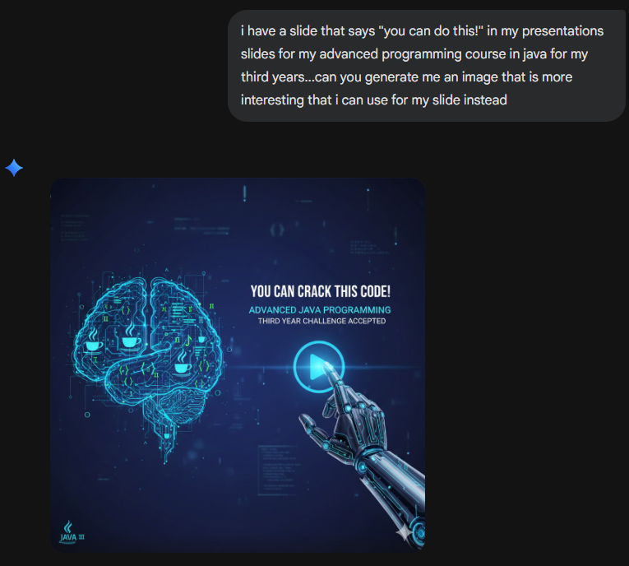

Slide 12
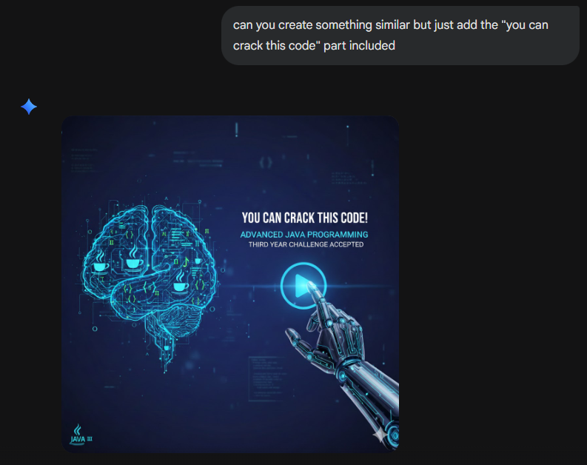

Slide 13
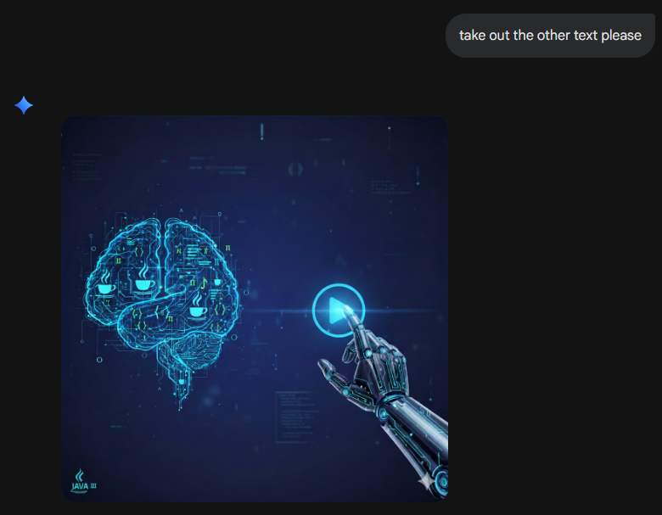
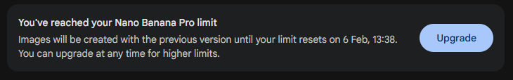

Slide 14
YOU CAN DO THIS!

Slide 15

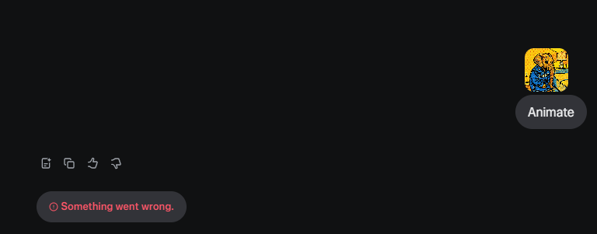
ChatGPT
elephant wearing jacket with ChatGPT on it sitting in the corner of the room
Notes:
Elephant in the room hoping not to be seen – obvious presence
Also has a jacket on
You just can’t miss it…but not sure if we should talk about it or use it…
* Image generated by Meta ai

Slide 16

How not to use AI tools
Copy & paste the assignment to ChatGPT
Copy & paste solution generated as your solution
Submit
Notes:
Don’t use it for generating comments if no marks awarded for that

Slide 17


A correct way to use an AI tool
[ChatGPT]
Generate an exercise
[You]
Attempt to solve it
[ChatGPT]
Ask for a solution
[You]
Evaluate solution (Is it correct? If not, fix it)
[You]
Compare to your solution (same, different, faster, data structures, algorithm, correct?)
Start here…
Notes:
Critical thinking is one of the most important skills to have now
Do not pass it off to an automated tool

Slide 18
Mark calculations
May vary but not likely
40% class mark AND 80% attendance required to write exams
Final mark calculation:
Final mark
40% Class mark
80% Test 1 & Test 2
20% Practical Assignments
60% Exam mark

Slide 19


For this module
Notes:
If you have not worked with java or IntelliJ, please come see me
Take a look at recap slides from last year

Slide 20

Reflective exercise
You have 10 minutes…
What is your why? Why are you here today in the WRPV301 class?
What work do you want to do when you graduate?
If you’re not sure about your role yet, is a software developer role an option?
What is your favourite LLM/AI tool to use?
Why do you like that tool?
What impact do you think AI will have on the software development field in the near future?
Notes:
You can also watch: https://live.worldbank.org/en/event/2026/ask-experts-making-ai-work-for-all?cid=ecr_al_wblreminder_en_ext-pre
Start watching at: 19:45

